Slide 1
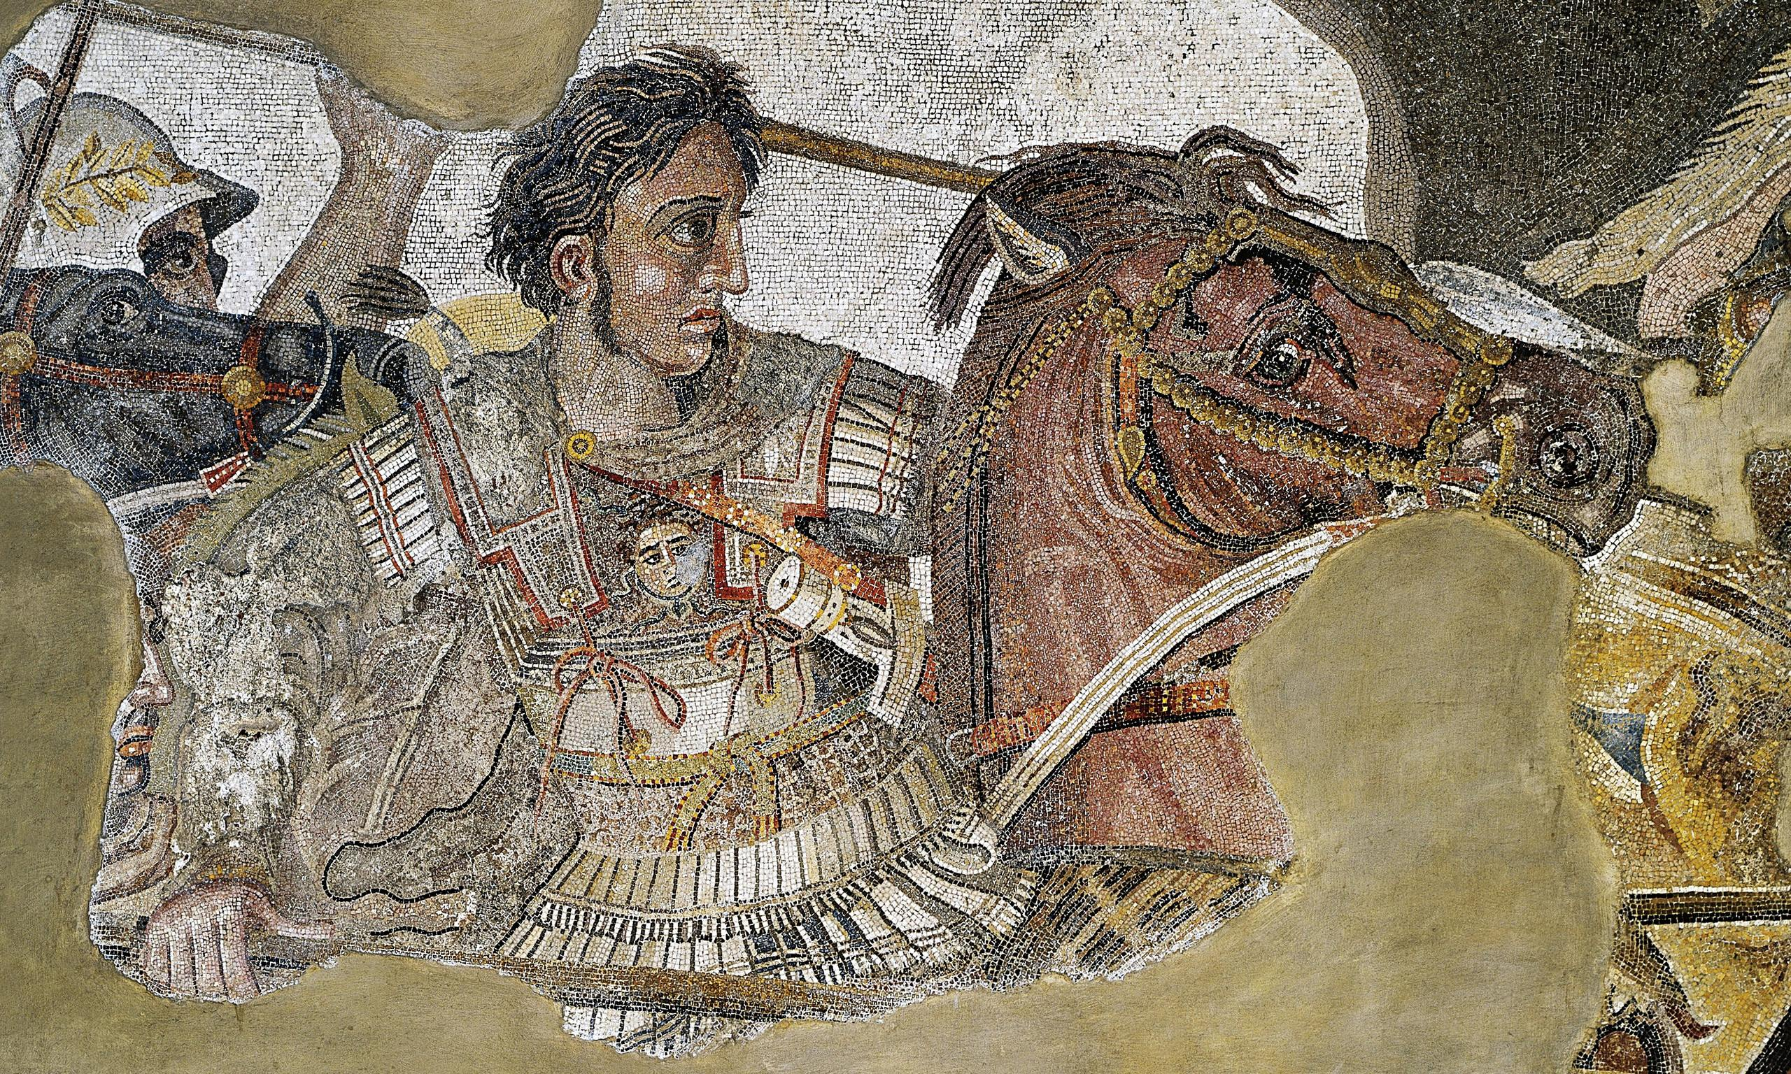
Documentary – Life of ATG
Goal/s:
Evaluate the life and legacy of alexander the great
Week 10 Lesson 8s – unit 2
Ms Barrie

Slide 2
Documentary:
https://www.youtube.com/watch?v=sp0YO9mAa6c&t=2198s&ab_channel=Get.factual

